Slide 1
Page Tables and Virtual Memory Design Concepts

Slide 2
Page Table of a process
Process
Table
0
OS Kernel
1
2
Process
Control
Block
Process
Control
Block
Program
Process
Control
Block
Process
Control
Block
Data
0
Frame #
1
2
Frame # where page is loaded into memory
MAX
Stack
MAX
Memory
Process Image
Page Table

Slide 3
Page Table Management
Size of address space of a process influences the maximum size of the page table
Can be huge for address spaces 2³² (4GByte) or 2⁶⁴ (16 Exabytes!)
Example:
Address space: 32-bit logical address space, 4GB
Page size: 4kb (2¹²), address space is composed of 2²⁰ (2³² / 2¹²) pages (1 Mio)
page table must allow 1 Mio entries (as many as the process requires)
If each entry in page table is 4 bytes (32-bit), then we may need 4MB of physical memory just to hold this page table !
We many not be able to allocate a contiguous area of physical memory
The page table itself may be subject to paging

Slide 4
Problems with Page Tables
Page tables can become very large.
One option could be:
Page tables themselves are held in virtual memory and are subject to paging
When a process is executing, those parts that are currently needed have to be in memory
Which part of the page table?
Possibly two page faults: reference to page not in memory, reference to page table part not in memory
Used Approaches
Hierarchical page tables
Inverted page tables
Hashed page tables
Hardware solution: use of associative memory to cache page table
Notes:
We won’t cover all the approaches

Slide 5
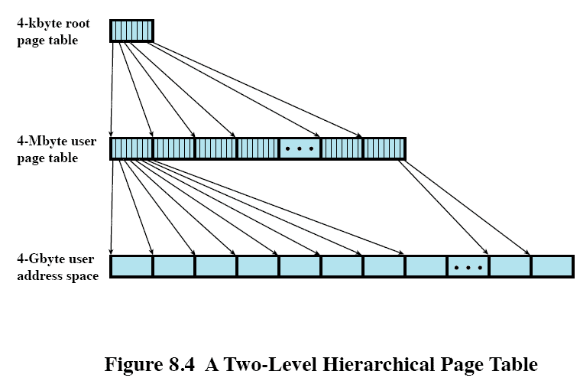
Hierarchical Page Tables
Multilevel Page Table
Page table may not fit into a single page, may occupy multiple pages itself
Create hierarchy of sub-tables
Extra page faults to load pages that contain page table information

Slide 6
Hierarchical Page Tables
If we assume a hierarchy of two tables:
Virtual address split into three parts
Root table index
Page table index
Page offset
Consider a 32-bit memory address
10 bits for root table: has 2¹⁰ = 1024 entries
10 bits for page table: has 2¹⁰ = 1024 entries
4kB per page: we need 12 bits (2¹² = 4096) to address a location within the page
Page offset
32-bit Virtual Address
10 bit
10 bit
12 bit
Root
Index
Page table
index

Slide 7
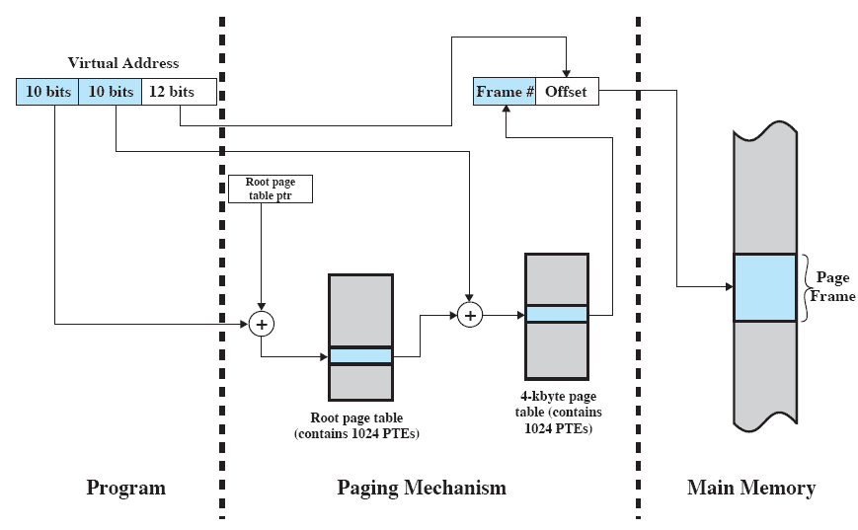
Hierarchical Page Table Address Translation

Slide 8
Inverted Page Table
An inverted page table has one entry per memory frame
Depends only on physical memory size
For physical memory with 2^{m} frames , table is of size 2^{m}, i^{th} entry refers to frame i
Only one page (frame) table for all processes
Has a fixed size, size of physical memory is known at startup of system
Table entry records
Process ID, Page number, Offset
Table is a hash table
Calculate hash value from page number
Hash value is index into page table, compare process id and page number, follow collision chain until match
Index of found entry is the required frame number

Slide 9
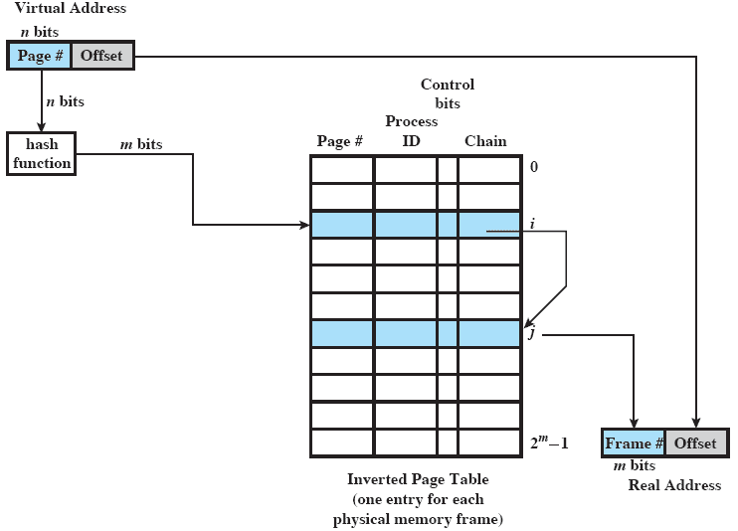
Inverted Page Table
Hash Collision Chain

Slide 10
TLB Translation Lookaside Buffer Paging Hardware Support
Problem with page table in main memory
In order to access a particular physical memory location, processor has to access memory twice
First, access page table via the page table base register to get the frame address
Second, calculate the actual physical address and access physical memory location (load or store data)
Memory access slows down 50% !
Standard solution
Translation Look-aside Buffer (TLB): special small and fast-lookup hardware cache

Slide 11
TLB Translation Lookaside Buffer
Translation Look-aside Buffer (TLB):
special small and fast-lookup hardware cache
Is special associative cache memory
Is associative memory, holds part of the page table (those pages the processor will access “most likely”)
Has to be reset and reloaded at each context switch

Slide 12
Translation Lookaside Buffer (TLB)
Logical
Address
CPU
p
d
TLB hit
p
f
f
PTBR
+
d
TLB
f
d
Page Table Base Register
p
Physical
Address
f
TLB miss
Page Table of running Process
Physical
Memory

Slide 13
Translation Lookaside Buffer (TLB)
Using the TLB
CPU generates logical address
“TLB hit”: If lookup of page number in TLB is successful:
very fast lookup of corresponding frame number
“TLB miss”: If lookup of page number in TLB is not successful:
find frame number in page table, slow lookup of frame numbers
Page number and found frame are added to the TLB (potentially replacing other entries according to a replacement policy)
TLB must be loaded with process-specific page table entries at each context switch

